Slide 1
Real Estate Analysis In Lagos State.
By J. EDOH
For Coursera Data Science Capstone Project

Slide 2
Introduction
To do a real estate analysis of the areas in Lagos and determine which areas would be profitable for investment.

Slide 3
Data Exploration
Data used for this project were gotten from the sources below:
- The Housing data website
- FourSquare API [ for Venue Locations and categories in each area]
- Google Map API [For the Geographical Location of the each area]

Slide 4
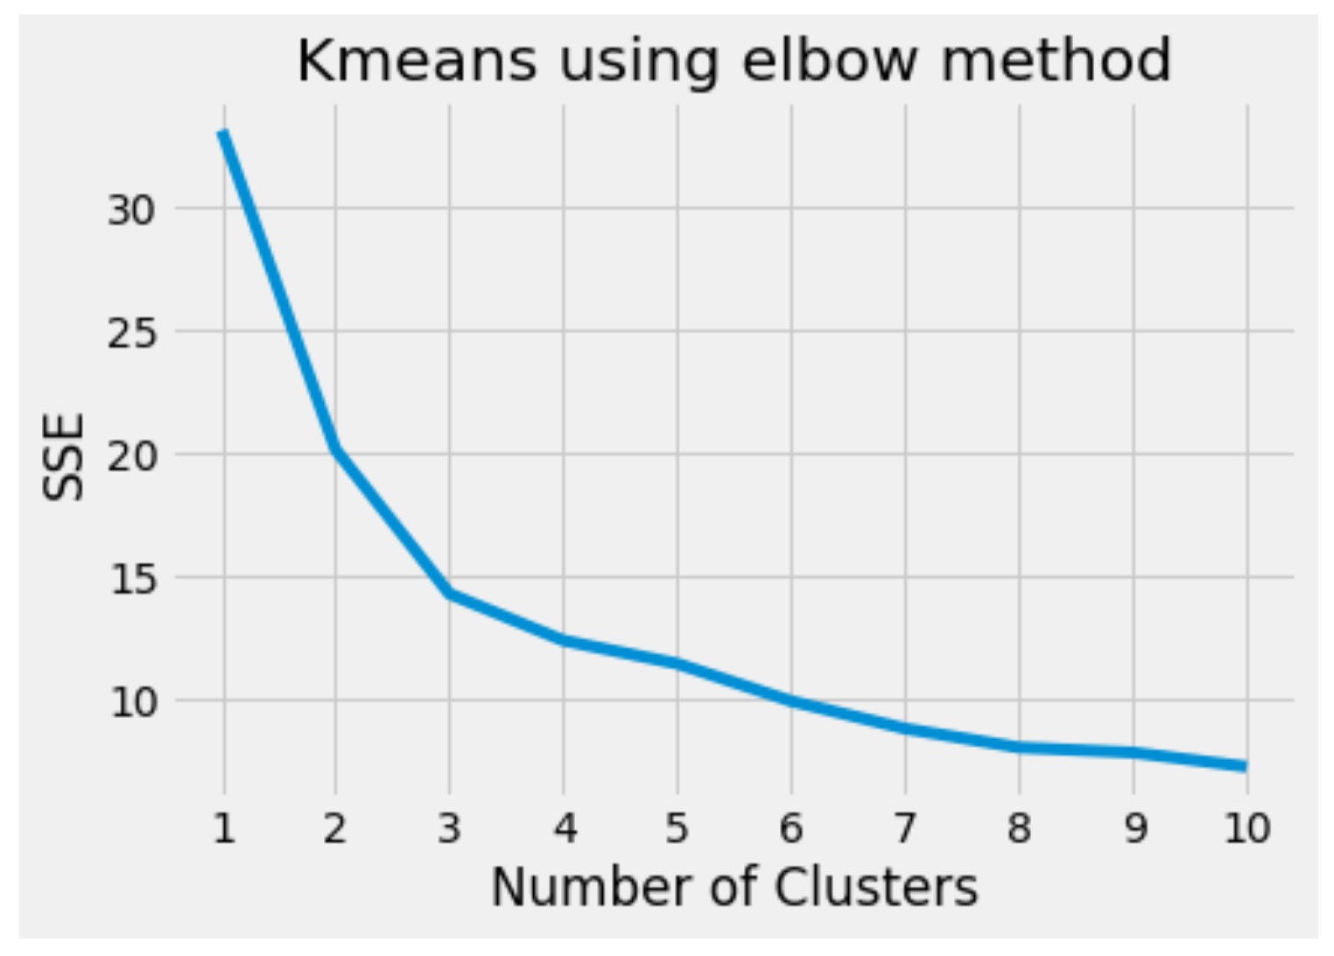
Methodology
- Using the One percent rule to determine the profitability of land or housing investments.
- Kmeans Clustering algorithm to cluster the areas based on geographical Coordinates
- Elbow method to find out the ‘K’

Slide 5
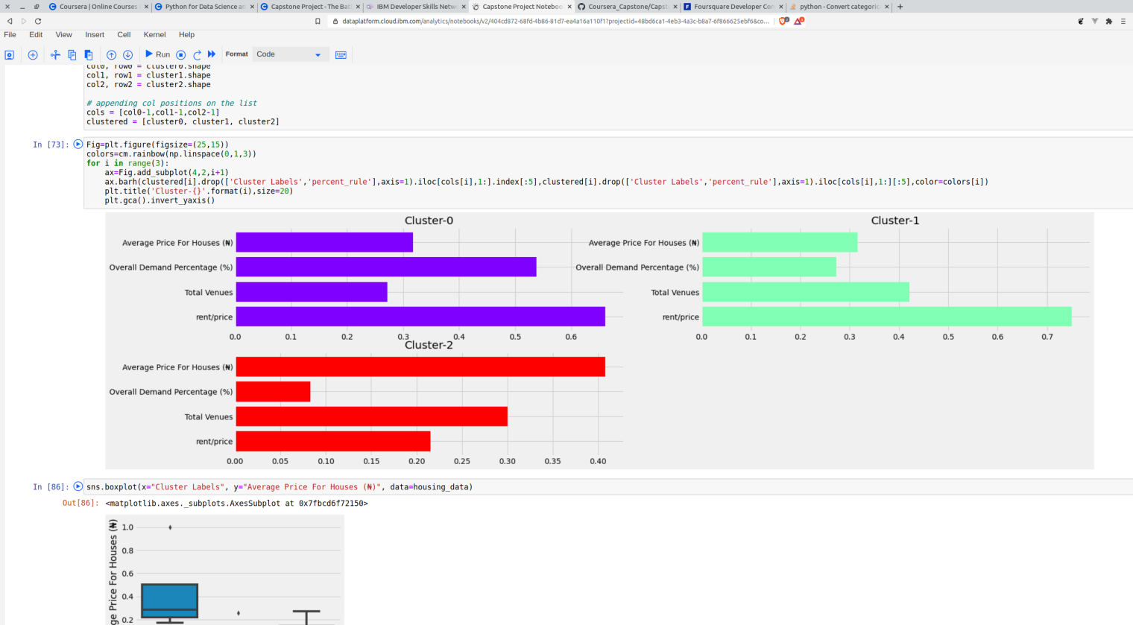
Clustering of Areas into 3 Segments

Slide 6
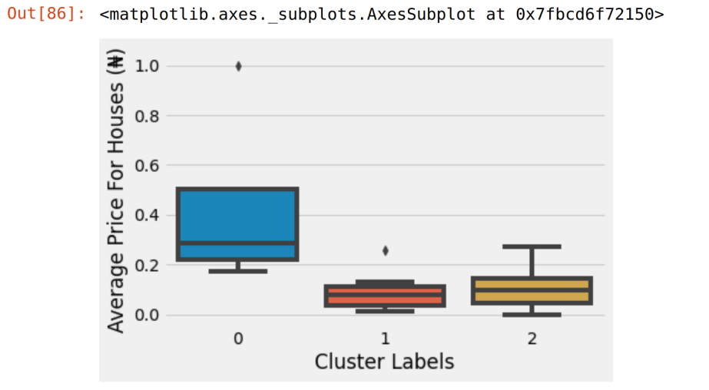
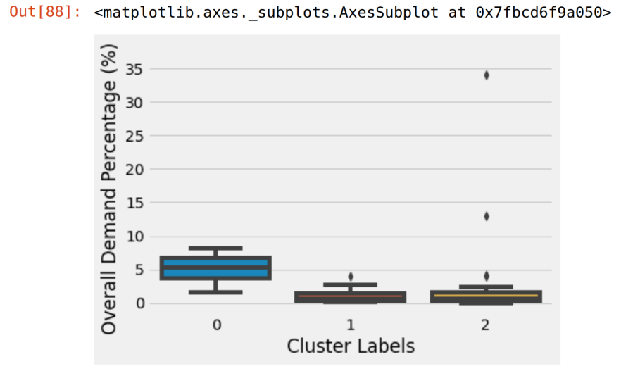
Result and Analysis
- Analysing the performance of each cluster against the feautures in the data set to determine which of them will be our ideal Cluster for investment

Slide 7
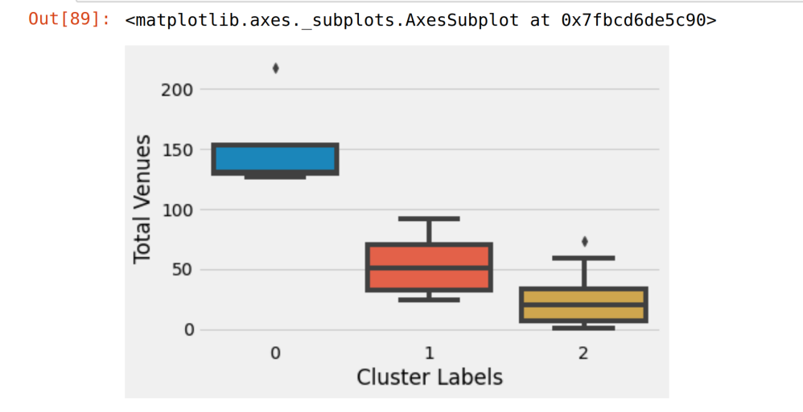
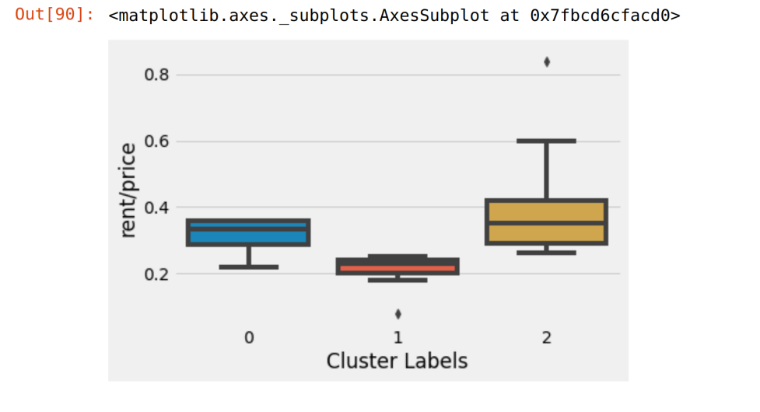
Result and Analysis contd
At the box-plots clearly shows, areas in cluster 0 are the top recommendations for investment

Slide 8
Discussion
Topics
- Outlining the limitations of our data
-Exploring the other metrics that can help improve our clustering like
- Cap Rate
- ROI

Slide 9
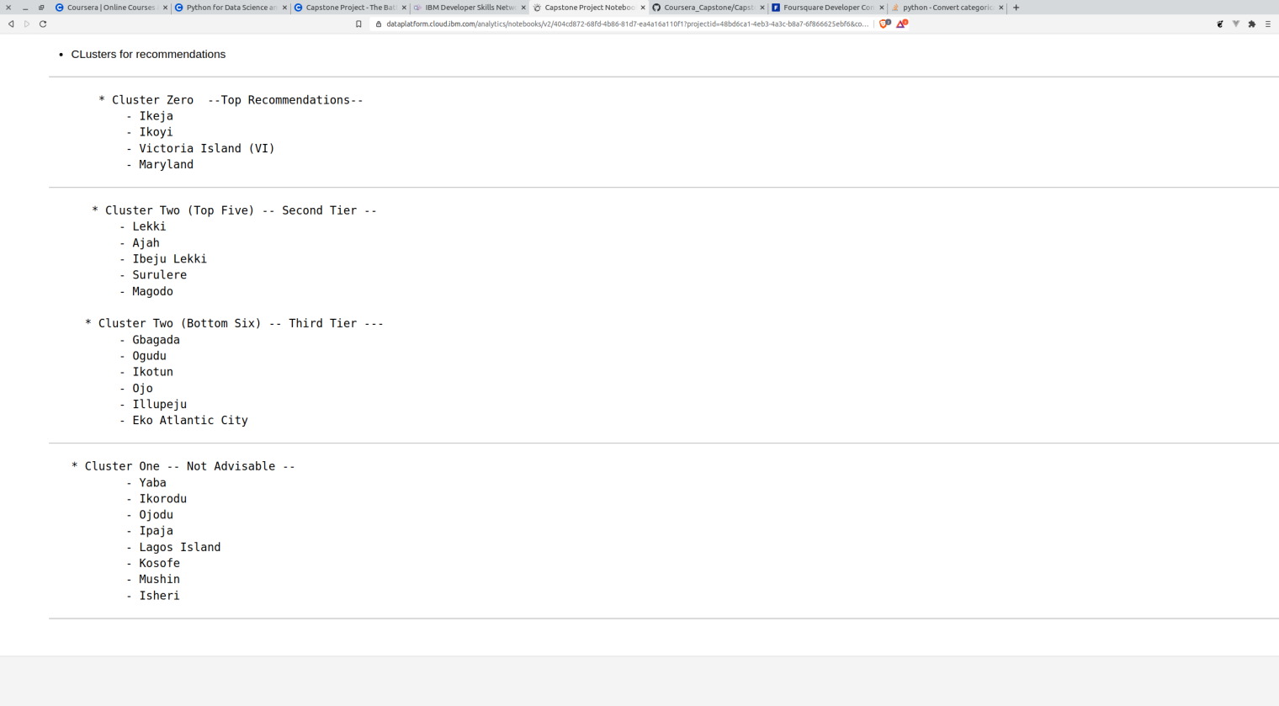
CONCLUSION
The following areas in the order of their investment potentials

